Slide 1

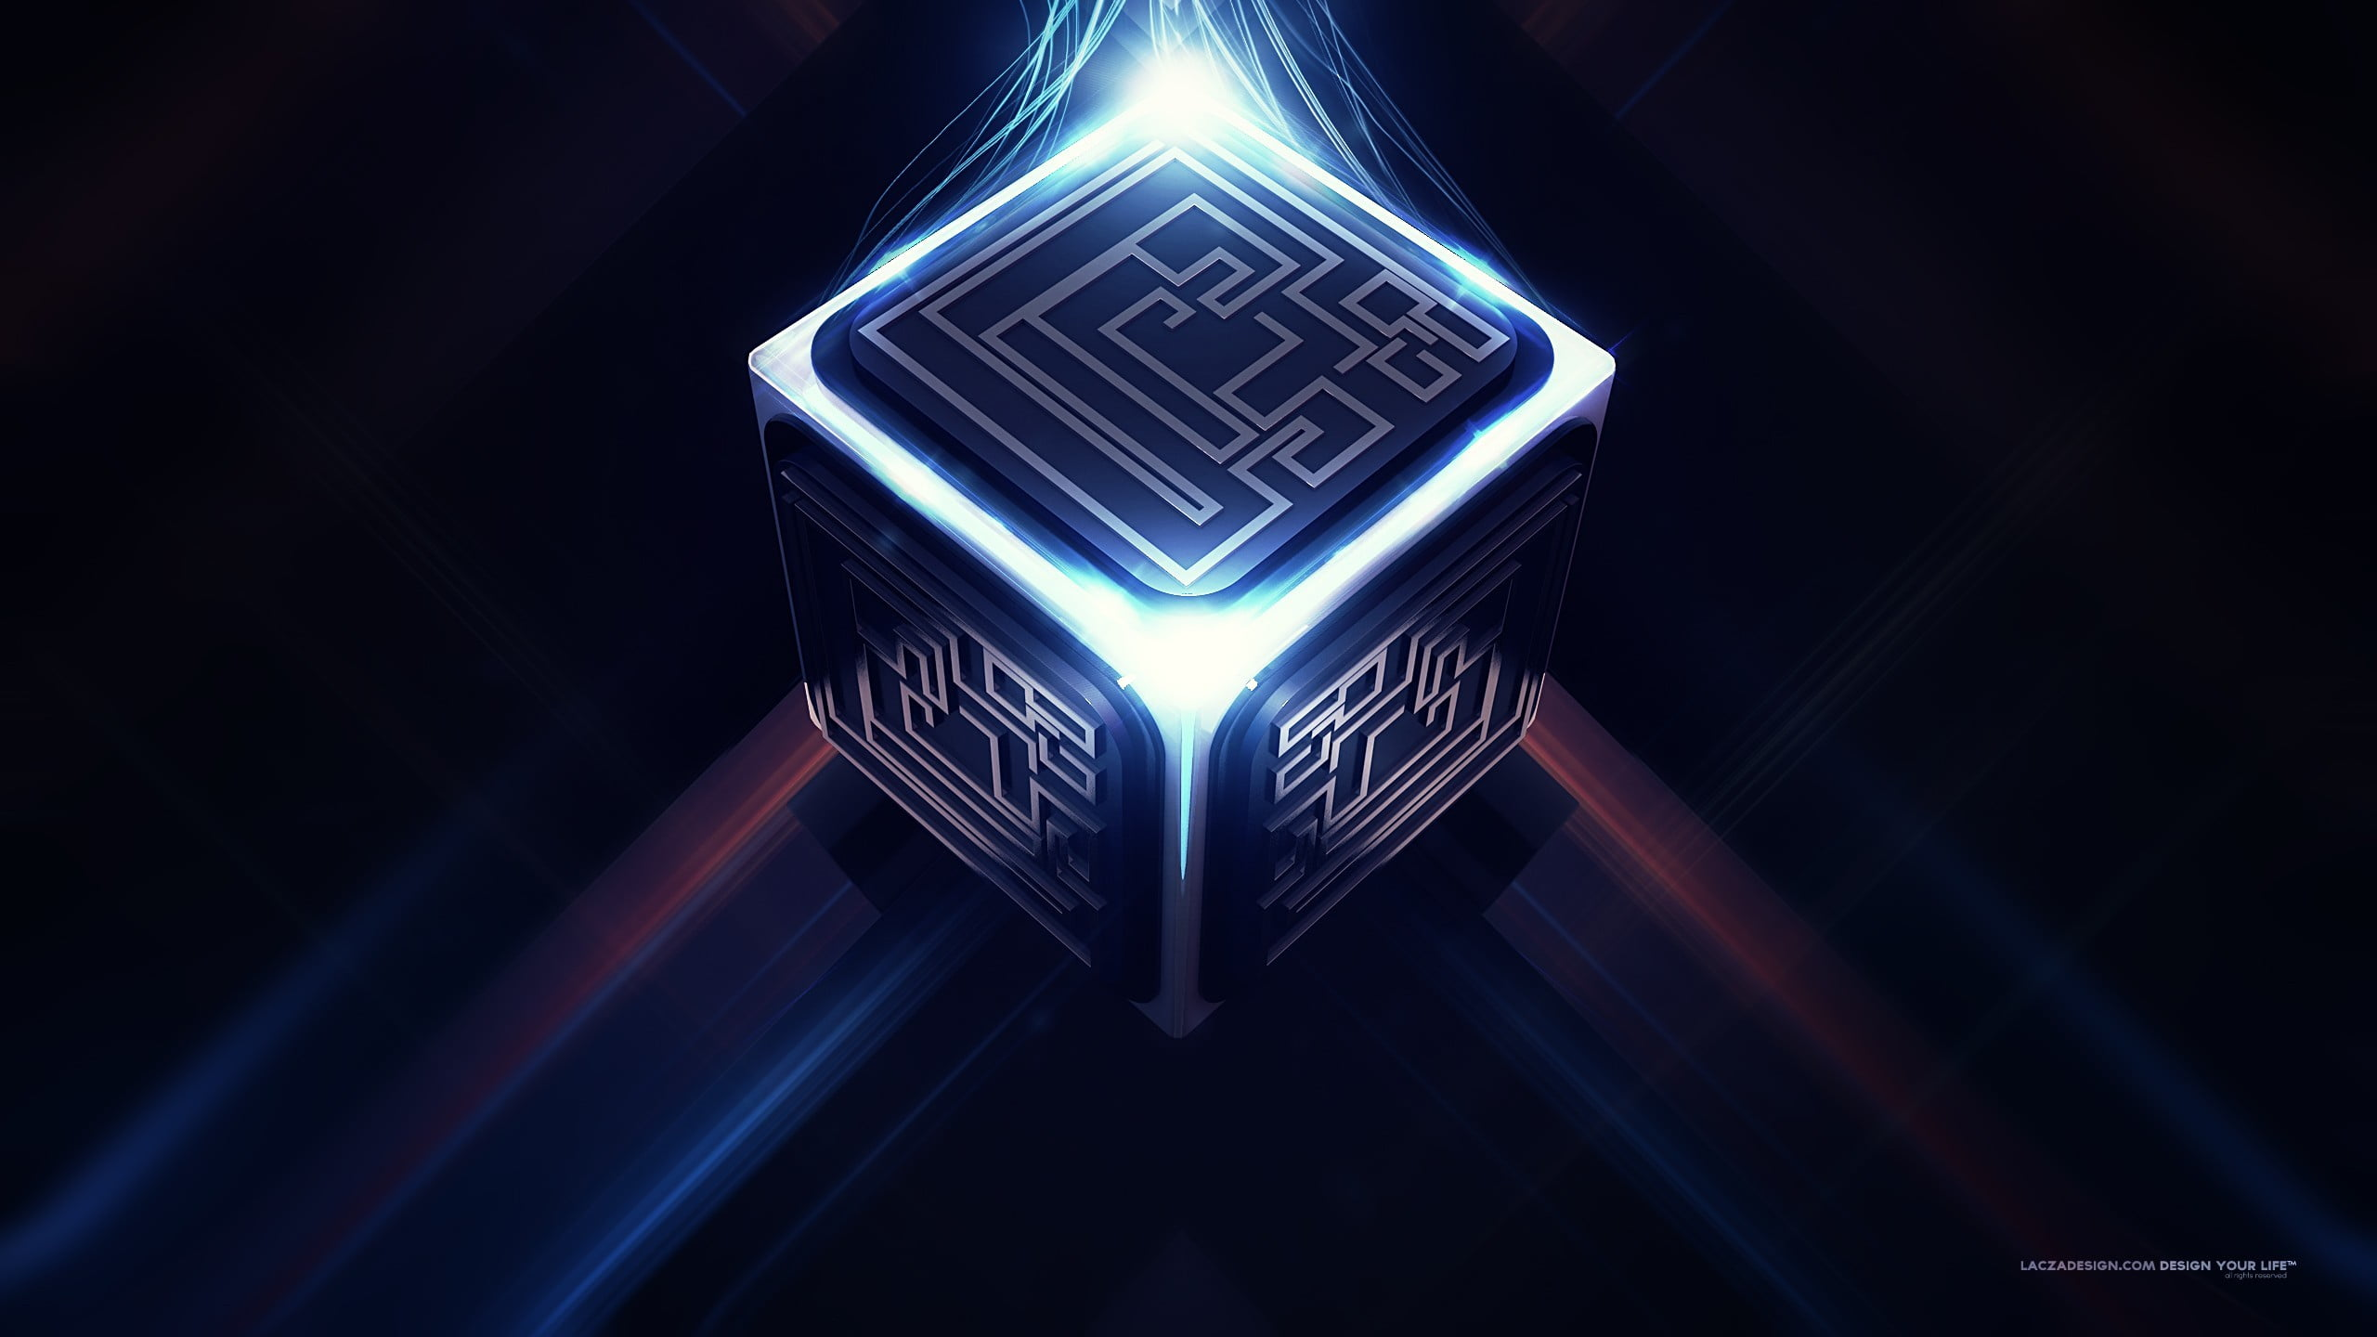
A!.OverFlow
Here is where the Future Begins……

Slide 2


ABOUT US
Our start-up is all about developing the automation culture in India and bring the possibilities of Artificial Intelligence and Machine Learning from the root level to top level. The primary goal is to provide automation and affordable-smart robots services.

Slide 3

AUTOMATING FROM THE BASE
Here’s what our Powergo flagship initiative is all about:
Our vision is to normalize the automation and automation services from the root level of the nation.
Developing most affordable, smart, powerful and featured robots and softwares will assist the society and businesses in exceptional ways.
An AI-tech statup, which will emphasis on design, improvisations, smartness and compatibility.
Initial and foremost priority is to the software solutions for almost all type of services from the detection of plastics in garbage to moving the fingers of a robot.
Why Automation? The future of AI is awesome and to keep up pace with the current AI developments in the world, the society at the root level of nation should also utilise it .
Use cases include the basic services to the advanced:
The fonts and colors used in the template.
More infographic resources, whose size and color can be edited.
Sets of customizable icons of the following themes: general, business, avatar, creative process, education, help & support, medical, nature, performing arts, SEO & marketing, and teamwork.

Slide 4

ABOUT US
OUR CLIENTS
01
03
OUR SERVICES
OUR TEAM
02
04
Simple to Complex AI-Solutions provider.
Business section and the society as a whole.
Automation and AI services including softwares and hardwares.
Highly skilled workforce with leading tech knowledge.

Slide 5
OUR EVOLUTION
Launch and setup with prototype AI-based softwares
2023
2024
Automation services including AI,ML,DS, etc.
Hardware services including robots
2015
2020
Integrating the C.R.A.I.

Slide 6
WHAT SETS US APART?
Jhansi
Delhi
Noida
We provide based solutions for various existing and non-existing apps/software
Neptune is the fourth-largest planet in our Solar System
Venus has a beautiful name and is the second planet from the Sun

Slide 7
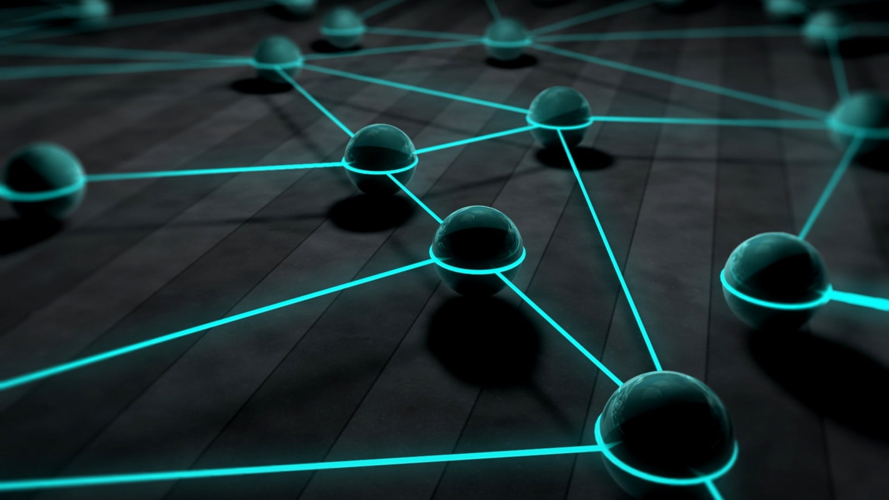
Company Prospects
01
Entitled to be a cool tech-startup here is our prospectus:

Slide 8
WHAT DO WE DO?
Quality design is the base of our Software System
AI, ML, DL, Cloud Computing, Mechatronics, Communication, Hydraulics,
AR, VR, Mixed Reality,
Saturn is composed of hydrogen and helium

Slide 9
HOW DO WE DO IT?
VENUS
Venus has a beautiful name, but it’s terribly hot
MERCURY
Mercury is the smallest planet in our Solar System
SATURN
Saturn is composed of hydrogen and helium

Slide 10
WHAT DO WE OFFER?
01 | 02 | 03 | 04
Mini-robots, smart-bots, Dark-Cell bots, MatrixAI, PowerAI, DrainOFFbot( for drainage, canal cleaning) | Assistance robots (staff, employess, etc.), household bots, Healthcare bots, Recetionist/Restuarant robo, etc. | AI-prototypes, AI-softwares and services for businesses and society | Saturn is composed of hydrogen and helium

Slide 11
OUR CLIENTS
Mercury is the smallest planet in our Solar System
Venus has a beautiful name, but it’s terribly hot
AI-VEINS
CR-ALPHA
JUPITER-X
TURN-BOT
Jupiter is the biggest planet in our Solar System
Saturn is composed of hydrogen and helium

Slide 12
WHAT DO THEY SAY ABOUT US?
MARS
VENUS
MERCURY
NEPTUNE
SATURN
JUPITER
Despite being red, Mars is actually a cold place
Venus has a beautiful name, but it’s terribly hot
Mercury is the closest planet to the Sun
Neptune is the farthest planet from the Sun
Saturn is composed of hydrogen and helium
Jupiter is the biggest planet in our Solar System

Slide 13
CASE STUDIES
Venus is the second planet from the Sun
Saturn is the ringed planet and a gas giant
VENUS
SATURN
MARS
MERCURY
NEPTUNE
Despite being red, Mars is actually a cold place
Mercury is the closest planet to the Sun
Neptune is the farthest planet from the Sun

Slide 14

OVERFLOW AI

Slide 15
OUR PROGRESS
OFAI-LMS
OFAI-Pay
Library Management System with OCR image processing technolgy to identify books, articles, etc.
Cardless transaction from ATM through UPI and AI proctored transactions to track frauds
MERCURY
MARS
Mercury is the closest planet to the Sun
Despite being red, Mars is actually a cold place

Slide 16
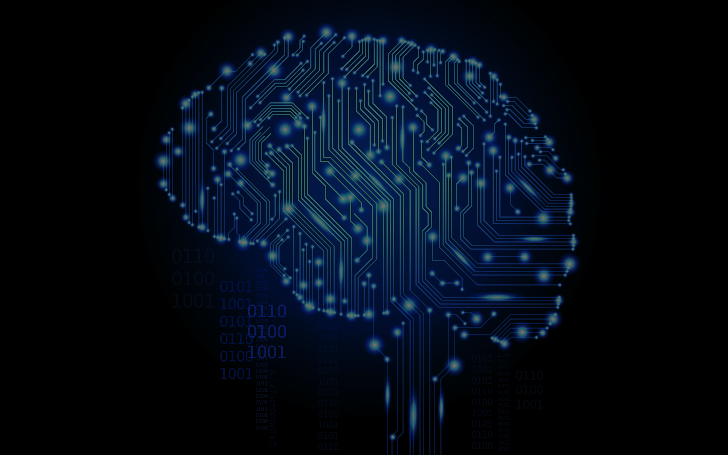
MEET THE TEAM
Adarsh
Sachin
Akash
Machine Learning Engineer
Artificial Intelligence Engineer
Mechatronics Engineer
Cloud Engineer
Data Science Engineer
Deep Learning Engineer
The WORKFORCE on lead:
Robotics Engineer
Software Engineer
Blockchain Developer

Slide 17
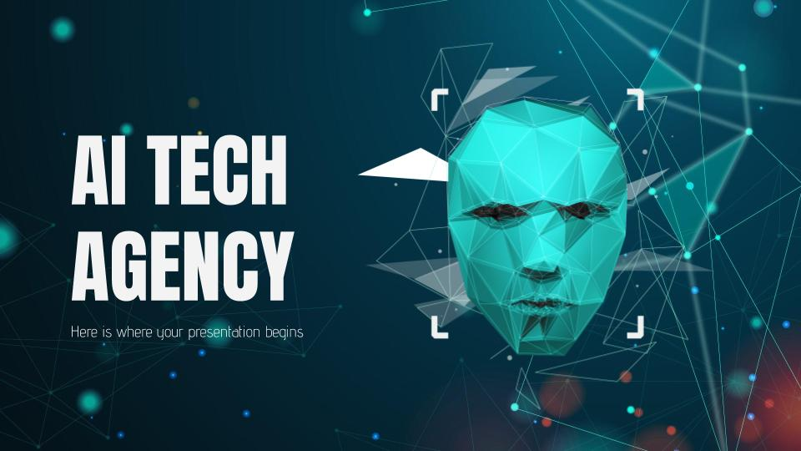
SOFTWARE DESKTOP
Mercury is the closest planet to the Sun and the smallest one in the Solar System—it’s only a bit larger than our Moon

Slide 18
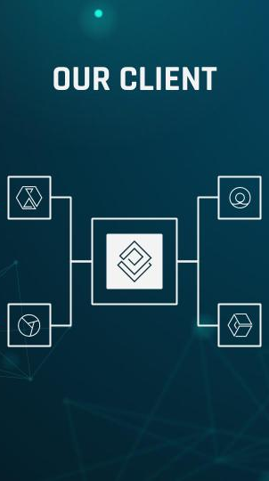
MOBILE APP
Venus has a beautiful name and is the second planet from the Sun. It’s terribly hot and its atmosphere is extremely poisonous

Slide 19

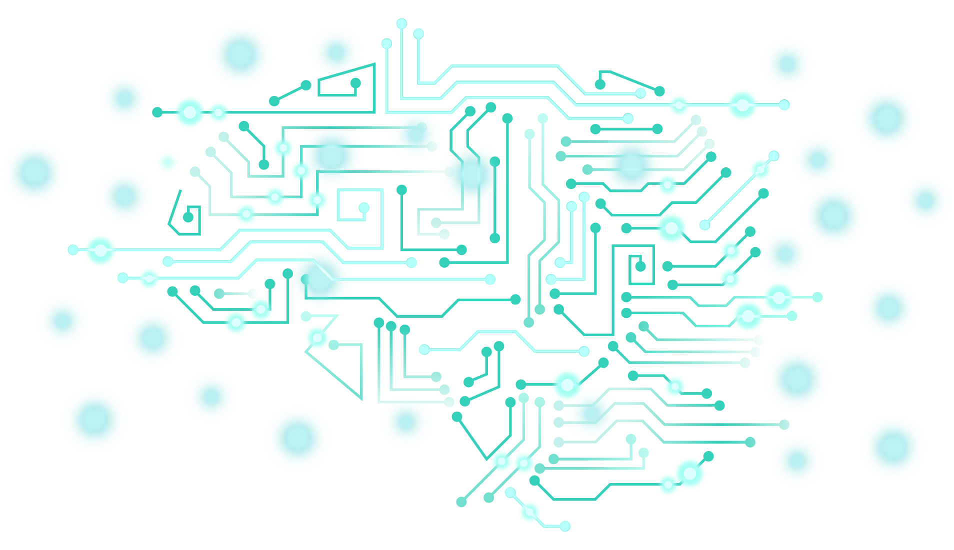
AI and the Future is Here

Slide 20
THANKS!
Do you have any questions?
bughuntersquadss@gmail.com
+91 6X0 4X1 8X8
AIOverFlow.com
Please keep this slide for attribution.

